Slide 1
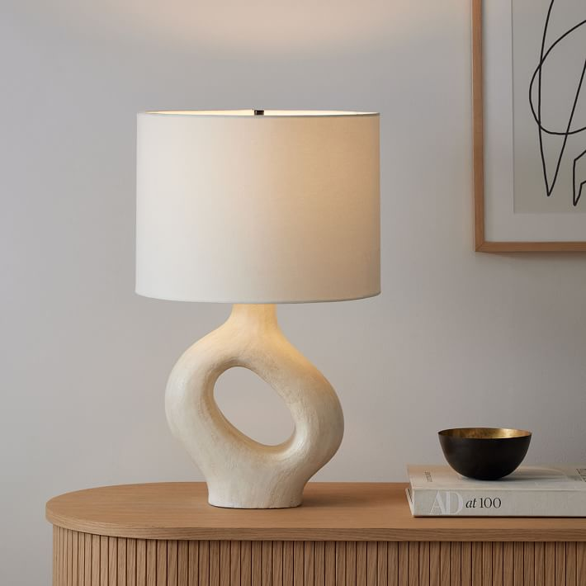
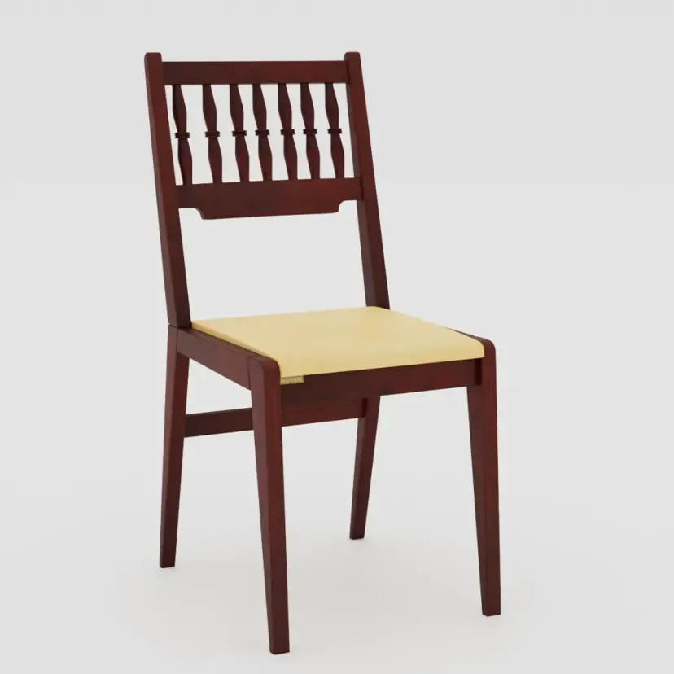
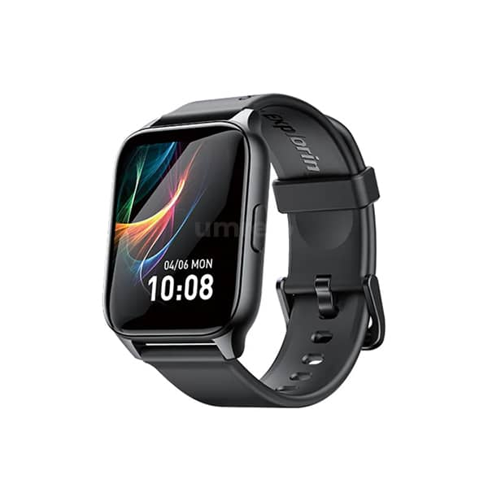
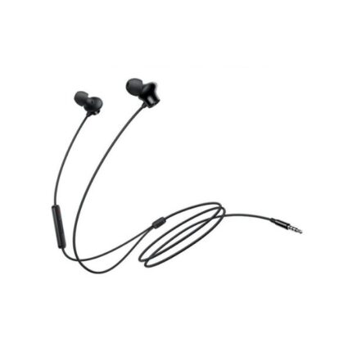
Product Catalog
Product Image | Product Name | Description
 | Modern Lamp | A sleek, energy-efficient lamp.
 | Classic Chair | Ergonomic design for comfort.
 | Smart Watch | Stylish and feature-packed.
 | Earphone | Superior sound and comfort for on-the-go listening.

